Slide 1

Overview/Introduction
A ski trip recommendation app that gives user information about:
Snow Condition
Weather
Crowd Index
Hotel Availability
Traffic Condition
Travel Time
Overall Recommendation Index
Motivation/Purpose

Slide 2
App Walkthrough
Role Play is a good approach!

Slide 3
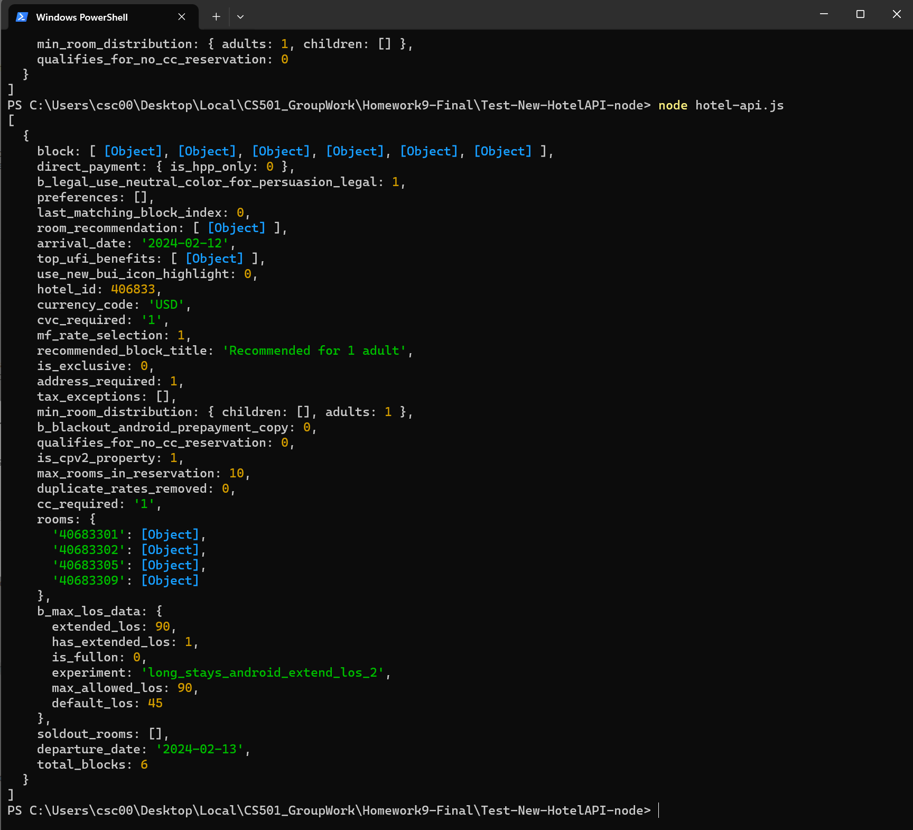
Roadblock 1
Hotel API does not have direct hotel availability data
Booking.com Room list of the hotel API Response
Workaround
Make two API calls:
1. Get selected date room list
2. Get 3 month later room list – assume this list reflect empty status
room_count
__________
3m_room_count
X100%

Slide 4
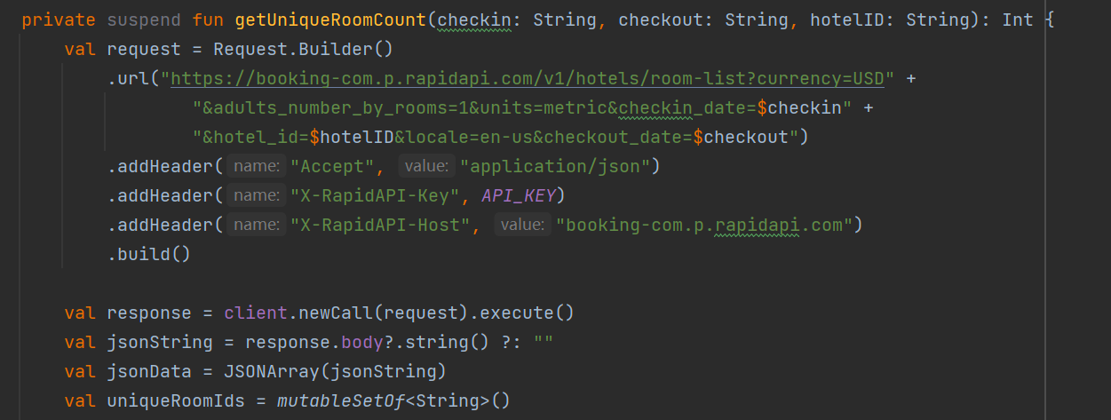
Booking.com Room list of the hotel API Response
Roadblock 2
No API handbook for Booking.com API:
1. Not available for general public
2. Different hotel have different booking policy
Workaround
1. Booking.com Search Hotel by Coordinates API
2. Google Map

Slide 5
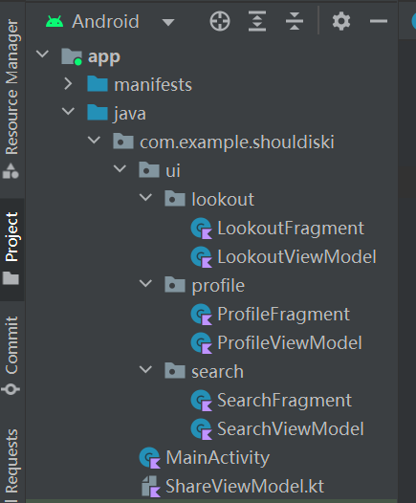
Roadblock 3
Data sharing between fragments
Workaround
1. Use ShareViewModel
2. Use LiveData and Observe

Slide 6

Roadblock 4
Database Setup
1. Supported Resort Database
2. User Preference Storage
Workaround
1. Two database with SQLite – Resort and Preference
2. YouTube Tutorial
3. Slightly different for two database and handling

Slide 7
Implementation Details, Including:
Roadblocks/Surprises/Workarounds
Roadblocks:
Database build up
Surprises : Hotel(API server outrage)
Workarounds

Slide 8
Implementation Details
What would you do differently?

Slide 9
Implementation Details
Future Work

Slide 10
Reference
1. Android Tutorial (Kotlin) - 30 - SQLite Database Creation and Insertion - YouTube

